Slide 1
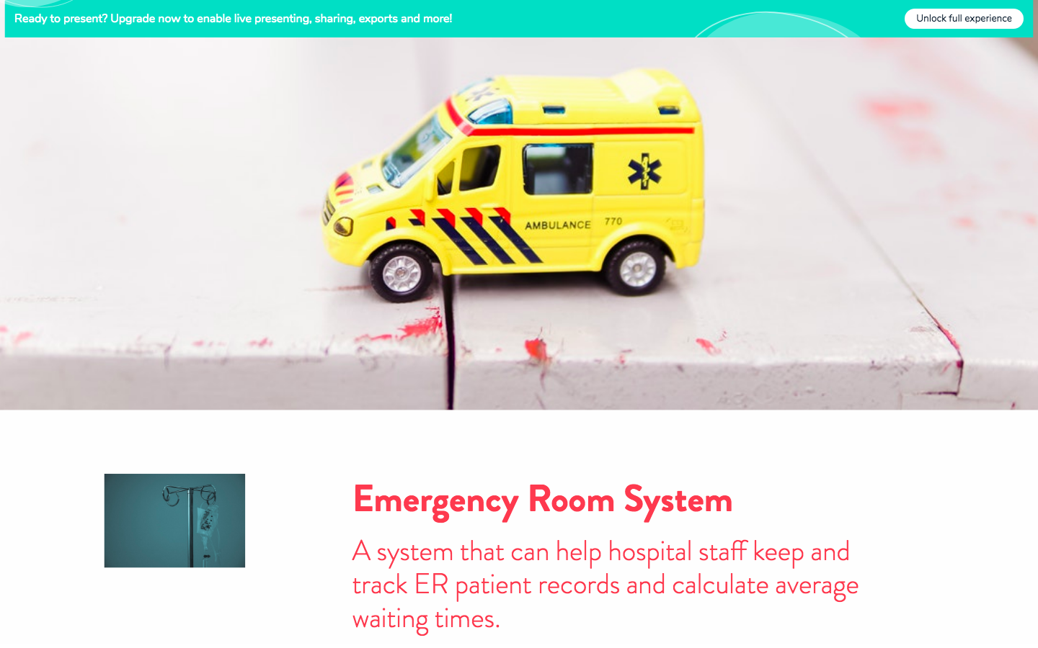

Slide 2
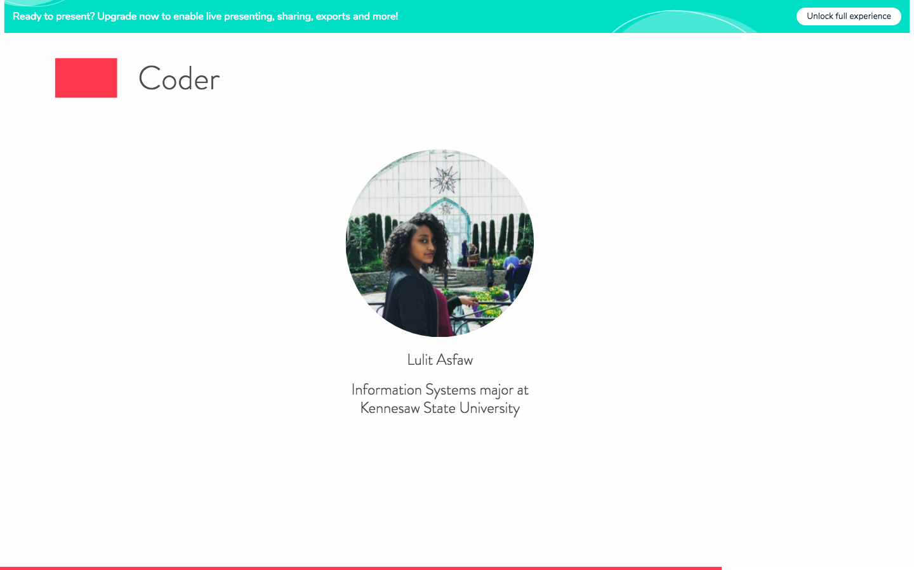

Slide 3
My Github Repository:
Emergency-Room-System: https://github.com/ksu-is/Emergency-Room-System/blob/master/ERsystem.py
Other sources:
Student-Record-System: https://github.com/sudipsingh04/Student-Record-System/blob/master/Program.py

Slide 4
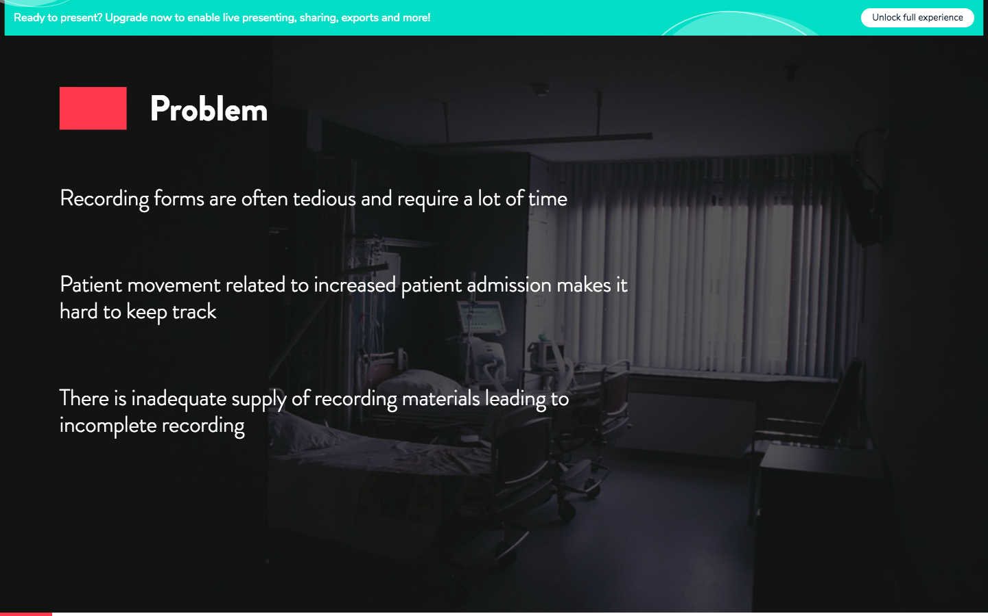

Slide 5
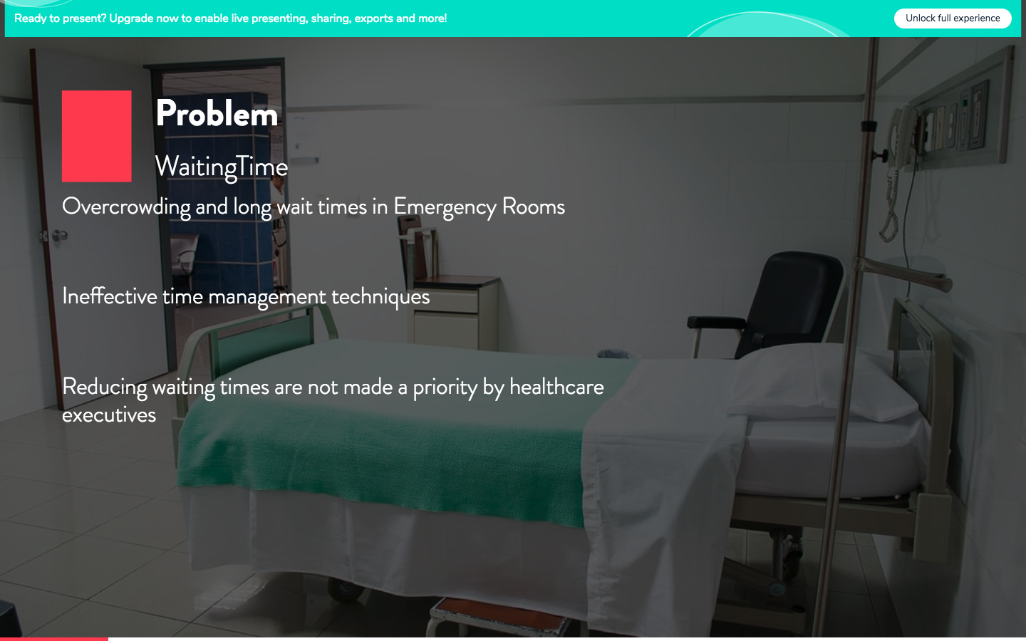

Slide 6
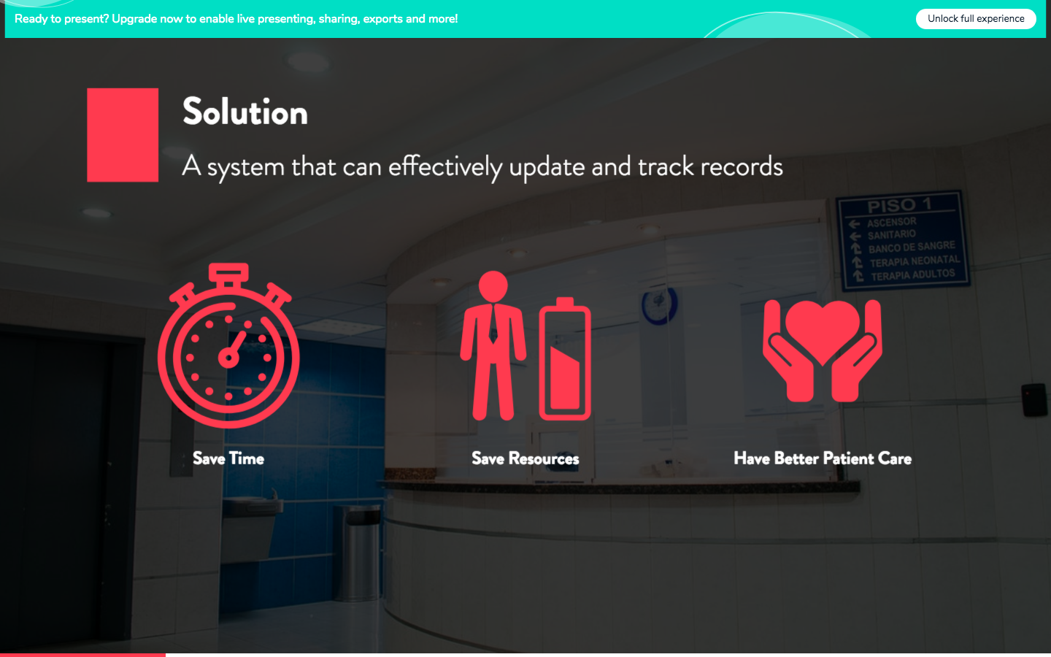

Slide 7
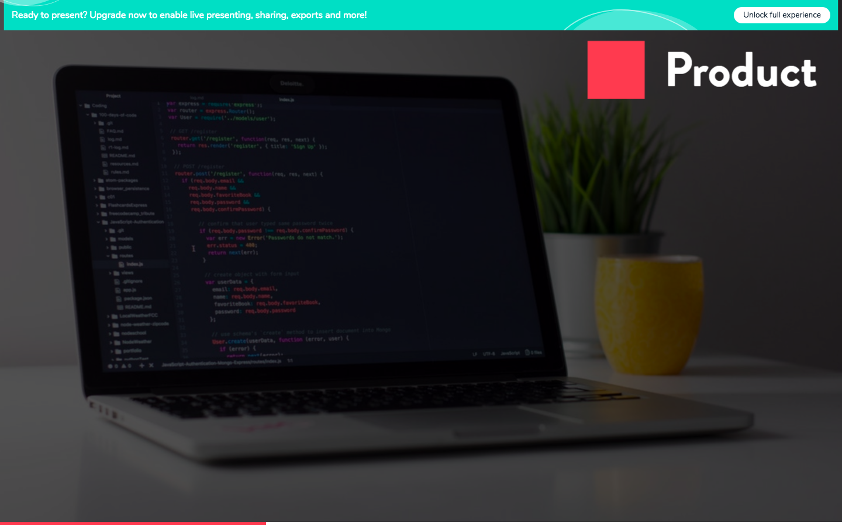

Slide 8
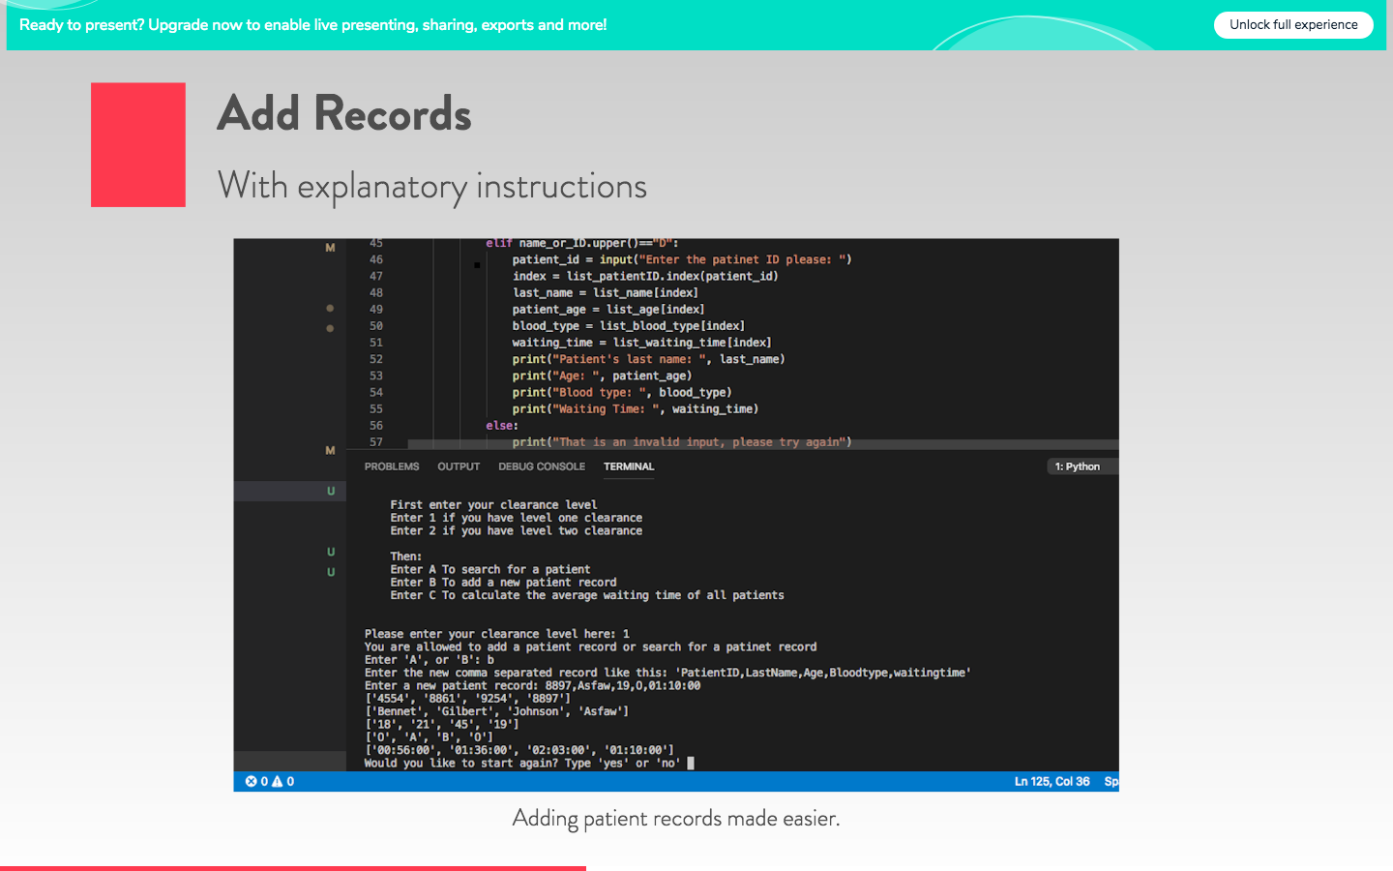

Slide 9
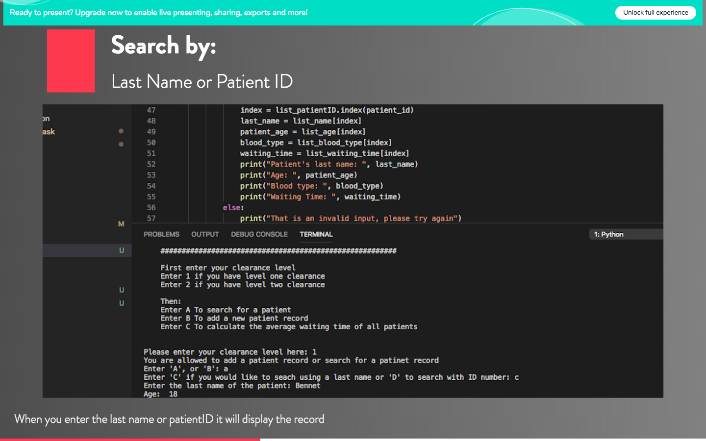

Slide 10
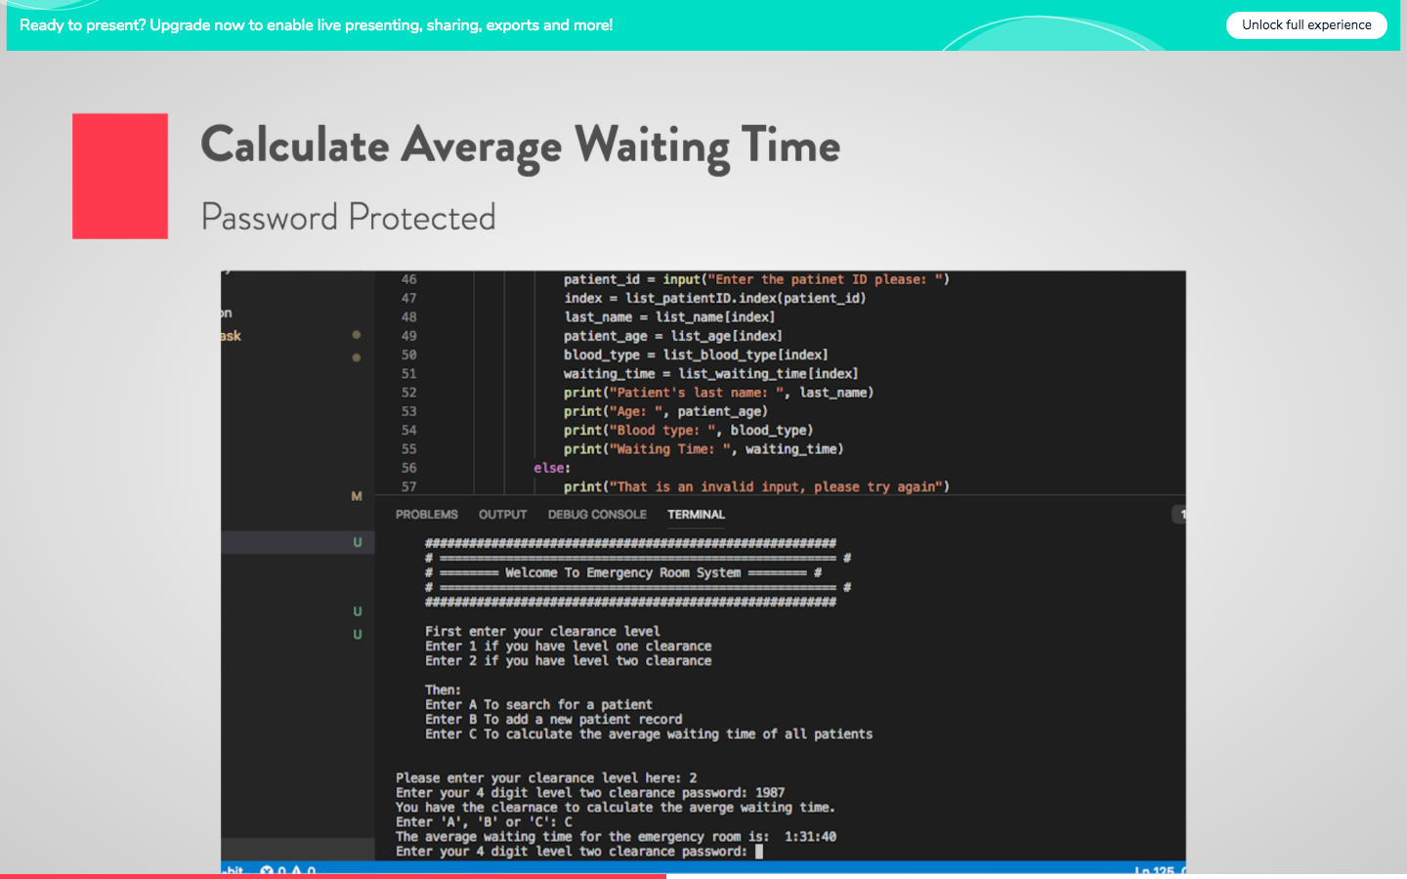

Slide 11
